Slide 1
G2M Insight For Cab Investment Firm
Submitted By: Farheen Fatima
Date : 14-Aug-2022

Slide 2
Agenda
Problem Statement
Dataset
EDA
Hypothesis and Testing
Conclusion

Slide 3
Problem Statement
XYZ is a private equity firm in U.S. Due to remarkable growth in the cab industry in last few years and multiple key players in the market, it is planning for an investment in the cab industry.
Objective : To provide actionable insights to help XYZ firm in identifying the right company for making investment.
Cab companies are i) Pink Cab
II) Yellow Cab.

Slide 4
Exploratory Data Analysis
To perform the analysis, following steps has been taken:
Merged all four datasets
Checked for the null values - null values not found in any of the dataset.
Converted categorical features into numerical features.
Calculated the correlation to separate the irrelevant features from the dataset.

Slide 5
Dataset
There are four datasets:
Cab_Data.csv - this file indicates details of transaction for 2 cab companies
Customer_ID.csv - this is a mapping table that contains a unique identifier which links the customer’s demographic details
Transaction_ID.csv - this is a mapping table that contains transaction to customer mapping and payment mode.
City.csv - this file contains list of US cities, their population and number of cab users.

Slide 6
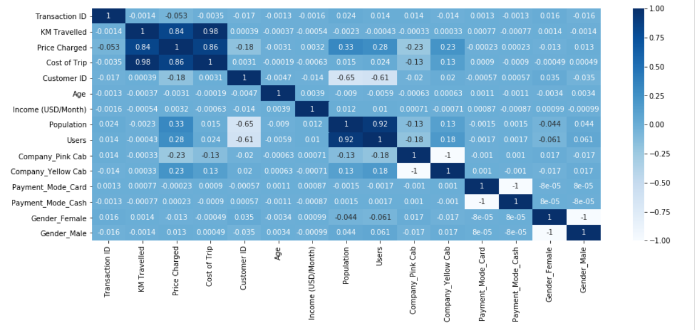
HeatMap

Slide 7
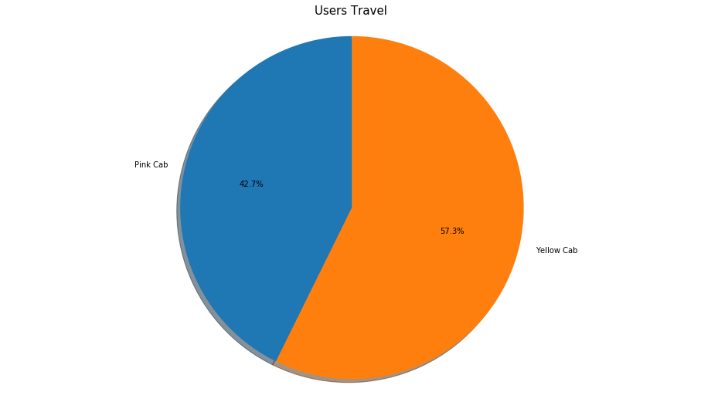
Users by Company
Yellow Cab has more users than pink cab company.

Slide 8
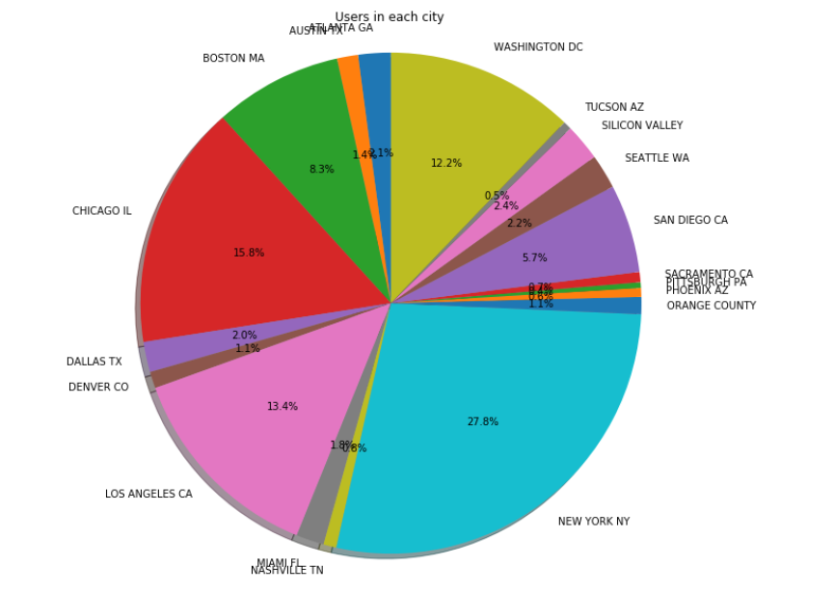
Users in each city
New York city has the highest cab users with 28%.
Chicago has the second highest cab users with 15.8%

Slide 9
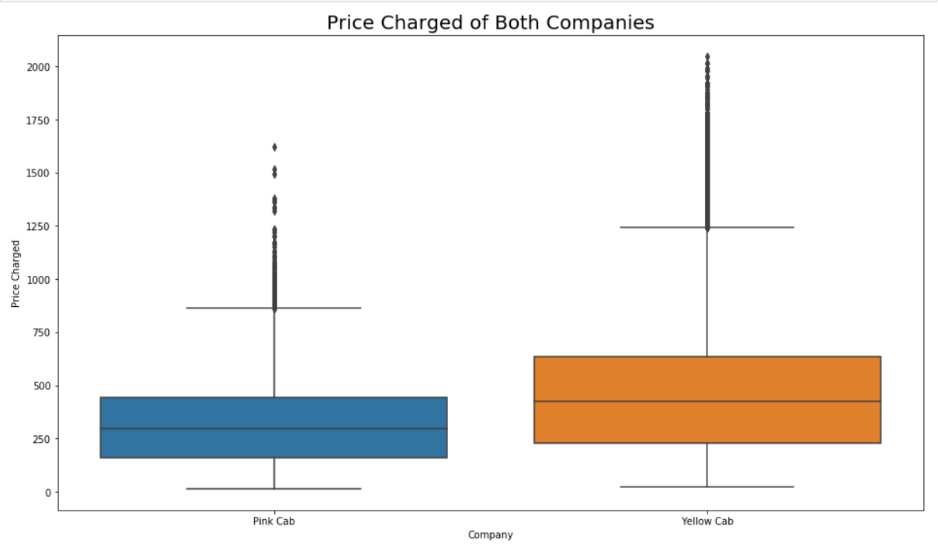
Price charged for both companies
Yellow cab is expensive than Pink cab.

Slide 10
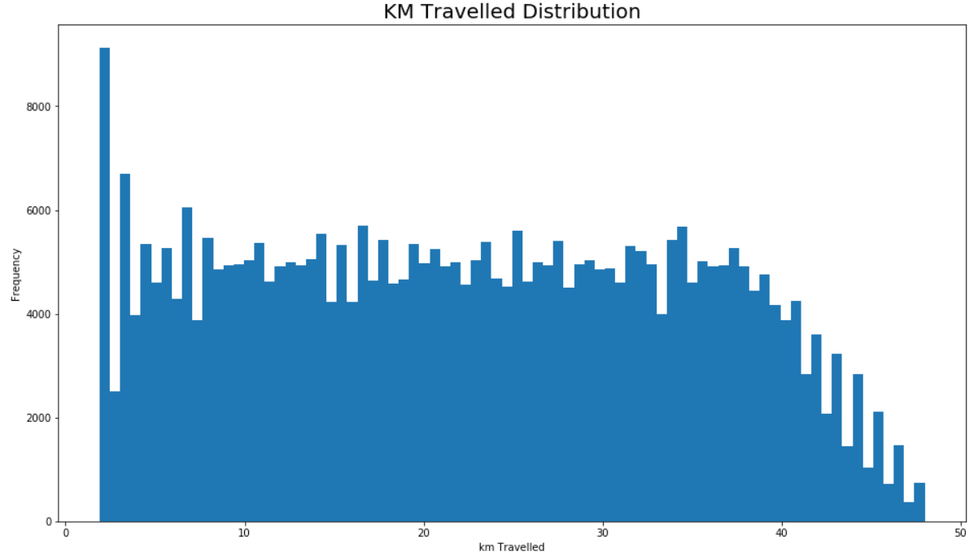
KM Travelled
Distance travelled by both the companies lies in the range 2 KM to 48 KM.

Slide 11
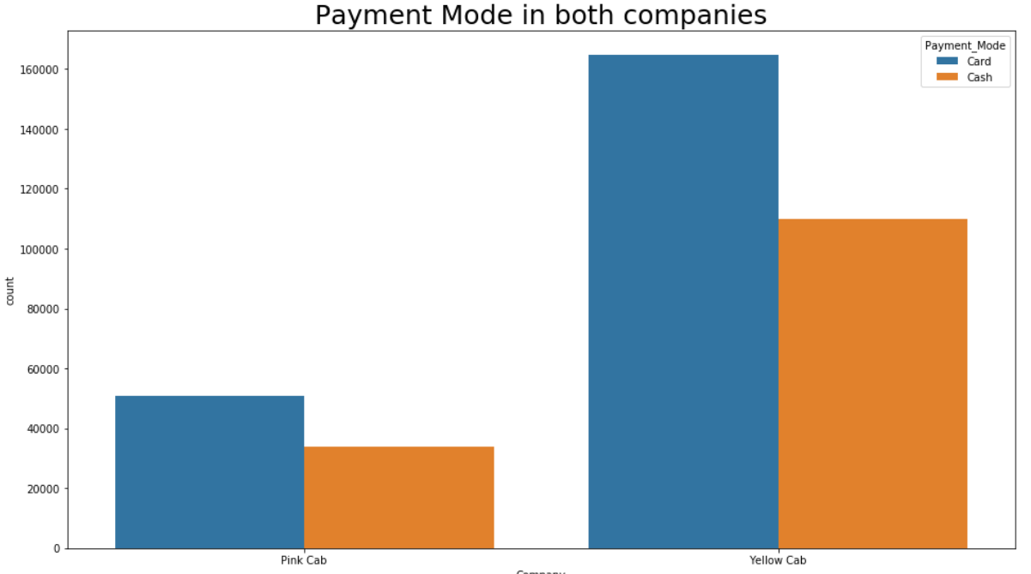
Payment Mode
Most users preferred card payment in both the companies.

Slide 12
Hypothesis Testing

Slide 13
Hypothesis 1: Difference in Margin by Gender
P values is 0.1151530
We accept null Hypothesis (H0) that there is no difference regarding gender for Pink Cab.
P value is 6.0604
We accept alternative Hypothesis(H1) that there is a difference regarding gender for Yellow cab.

Slide 14
Hypothesis 2: Difference in Margin by Age
P value is 0.79004
We accept null Hypothesis (H0) as there is no difference regarding age for Pink cab.
P value is 6.328
We accept alternative Hypothesis(H1) as there is a difference regarding age for Yellow Cab.

Slide 15
Hypothesis 3: Difference in Margins by Payment Mode
P value is 0.79004
We accept null Hypothesis (H0) as there is no difference in payment mode for Pink cab.
P value is 0.2933
We accept null hypothesis (H0) as there is no difference in Payment mode for Yellow cab.

Slide 16
Conclusion
Based on the above analysis and hypothesis results:
Yellow cab company is better than Pink cab company for the following reasons:
More users
Profit Margin

Slide 17
Thank you!

